Slide 1

TIME
SEE and SEE AGAIN

Slide 2
What is time?
Time – every leader has the same amount of time.
  Every day - 24 hours, 1,440 minutes, and 86,400 seconds.
Time is a measured resource.
We define our workweek by the number of hours in a day.
There is a list of things to do and only a certain amount of time to do them.
The word “time” is the English translation from the Greek, chronos and kairos.

Slide 3
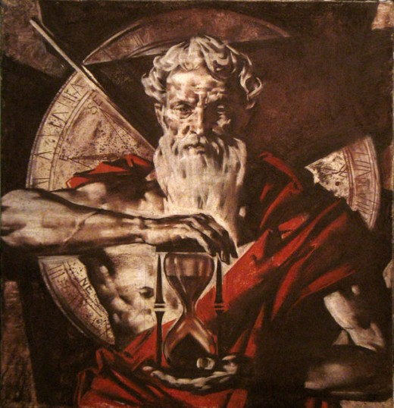
CHRONOS

Slide 4
Time – Chronos
Chronos - the Greek god – held time in his hand.
  Chronos – a space of time, either long or short, a duration.
  We should number our days, and be good stewards of our time.
Chronos – he was the personification of time in pre-Socratic philosophy.

Slide 5
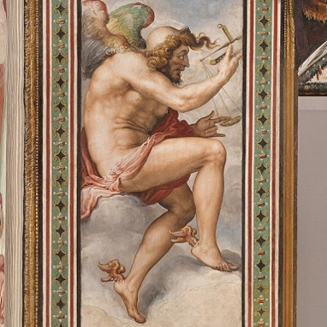
KAIROS

Slide 6
Time - KAIROS
Kairos – the Greek god of opportunity
  Kairos - a measure of time, a fixed definite time, when things are brought to crisis, the decisive epoch waited for, an opportunity.
The hair flock stood at the front of his head. As Kairos or “opportunity” approached one must seize the hair on front of Kairos.
Seize the opportunity because once he flew by, with his winged heals, he was gone. There was nothing to grab on the back of his head.
Once he passed - opportunity had passed.

Slide 7
Redeem the time
Ephesians 5:15-16 (ASV)– The Apostle Paul tells us to redeem the time. Our kairos, not our chronos.
“Look carefully how you walk, not as unwise, but as wise; redeeming the time, because the days are evil.”

Slide 8
REDEEMING THE TIME
Redeem our time
  Redeem = (gk) “to buy up, and make wise and sacred use of every opportunity for doing good…”
  For the word “time” Paul deliberately chooses “kairos,” not “chronos”
  Buy up the opportunity. Seize the opportunity.

Slide 9
Band of brothers
First Sergeant “Carl” Lipton, Easy Company, 2nd Battalion, 506th Parachute Infantry Regiment, 101st Airborne Division – WWII
He, the leader of his platoon, seizes Kairos.

Slide 10
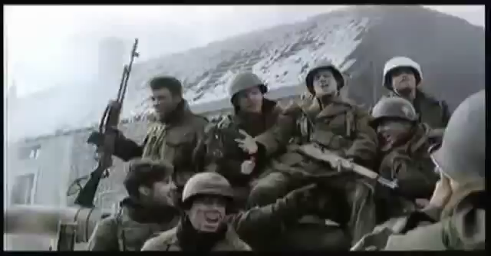

Slide 11
KAIROS - Seize the opportunity
As a leader will you seize the opportunity, “kairos”, for yourself or for others ?
Servant Leadership calls !!!!

